Slide 1

Capstone Project
Amazon Product Review Analysis
Inventory Optimization and Demand Forecasting
A presentation by Anuron Mitra, Rushikesh faDtaRe and Manisha mahapatro

Slide 2

AGENDAS OF THE PRESENTATION
Problem Overview
Analysis Process
Conclusion

Slide 3

Problem Overview :
Inventory Optimization and Demand Forecasting
Optimize inventory management by identifying the product categories (Clustering as an outcome of text processing) on the customer review data. Predict what kind of products could be in demand (Time Series Analysis).

Slide 4
Analysis Process :
text and data processing
NLP for sentiment analysis
Clustering to group the data
Time series forecasting

Slide 5
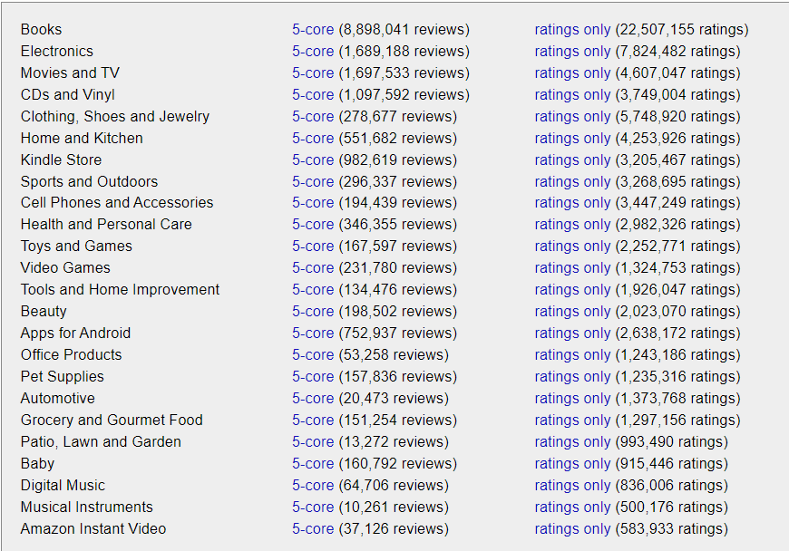
Source of the dataset
http://jmcauley.ucsd.edu/data/amazon/
From Amazon Product Review we have chosen Video Games and Toys & Games dataset

Slide 6

Text and Data Preprocessing

Slide 7



Importing Dataset In JSON Format
Importing Dataset in the JSON format
Exporting Dataset Into CSV Format
Exporting the Dataset from JSON format to CSV format

Slide 8
Steps :
Importing the necessary libraries
Importing data from the CSV file
Merging the 2 datasets into one dataset
Cleaning the review data
Tokenizing and
Lemmatizing

Slide 9
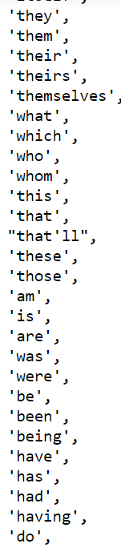
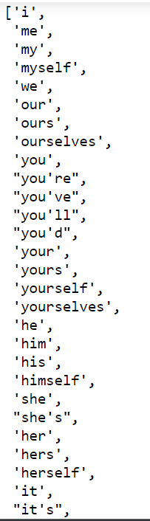
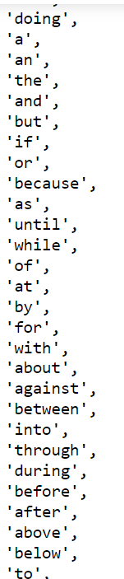
Stop words are available in abundance in any human language. By removing these words, we remove the low-level information from our text in order to give more focus to the important information.

Slide 10

sentiment analysis

Slide 11
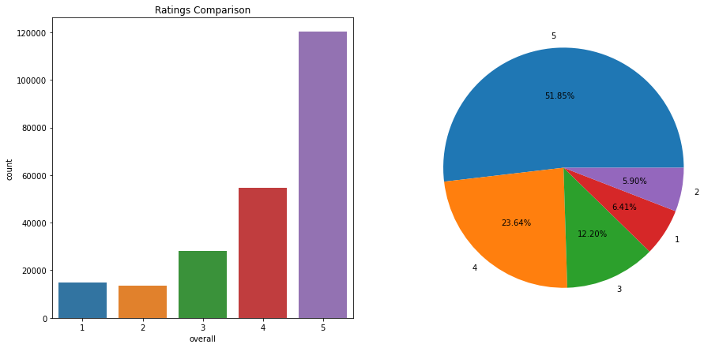
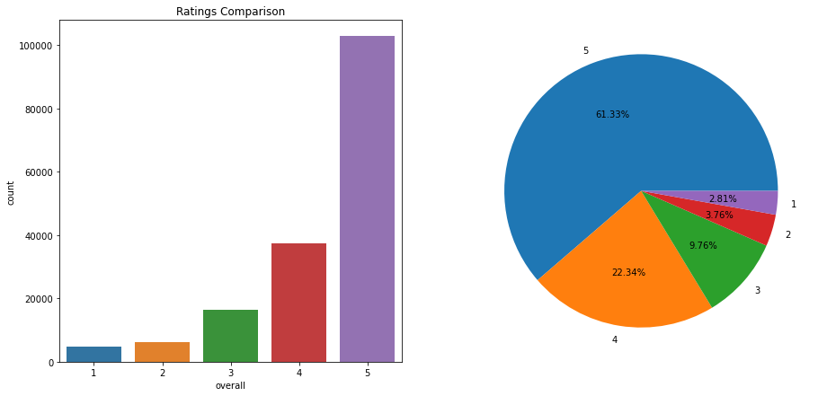
Exploratory Data Analysis
As we can see the overall rating is 5 for most of the categories in both datasets
Video Games
Toys and Games

Slide 12
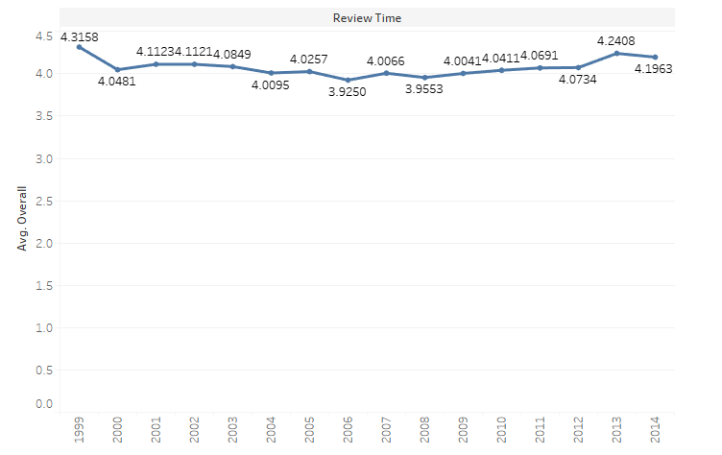
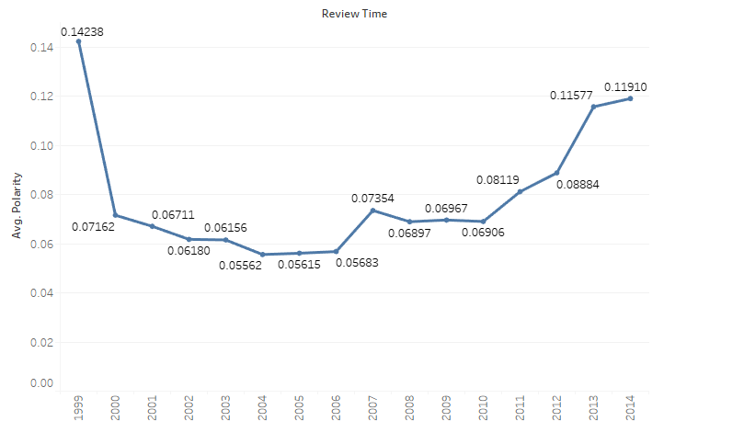
Average polarity and ratings over the years for Video Games
Average Overall Ratings
Average Polarity
As we can see the average of overall ratings has decreased over the years.
The average polarity has started increasing from 2010 after decreasing for several years.

Slide 13
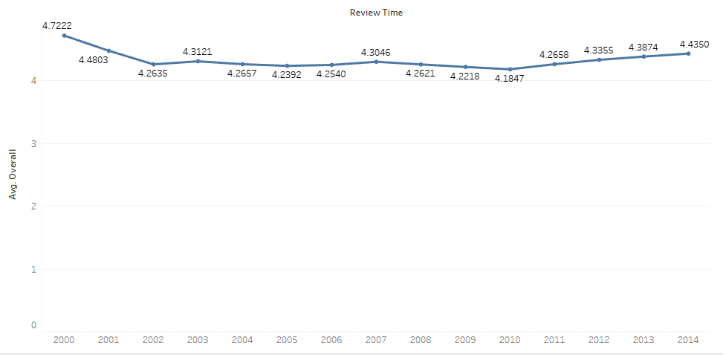
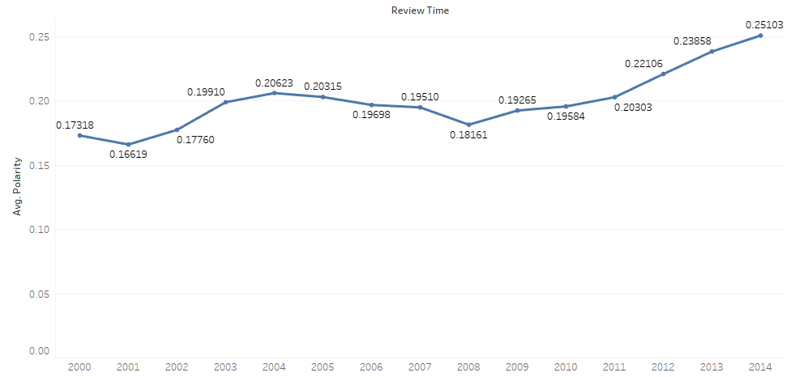
Average polarity and ratings over the years for Toys and Games
Average Overall Ratings
As we can see the average of overall ratings has decreased over the years, but form 2011 it’s on an increasing trend.
The average polarity has started increasing from mid 2008 after decreasing for several years.
Average Polarity

Slide 14
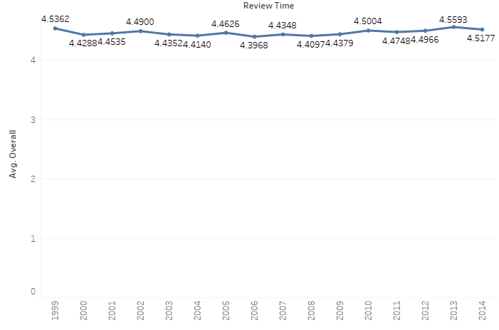
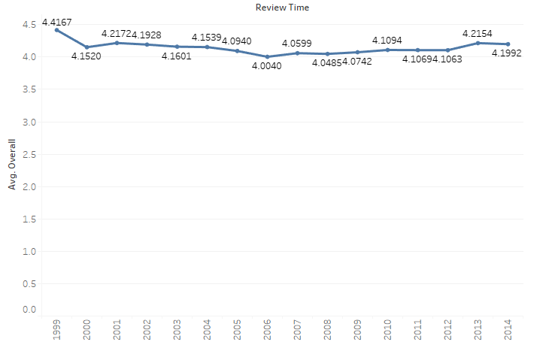
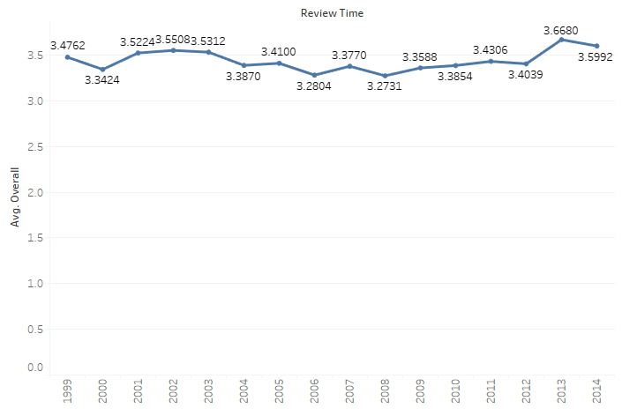
Average positive, negative and neutral ratings over the years for Video Games
Negative Sentiment
Positive Sentiment
Neutral Sentiment

Slide 15
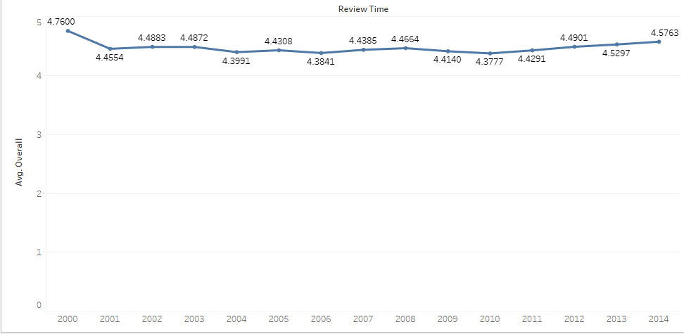
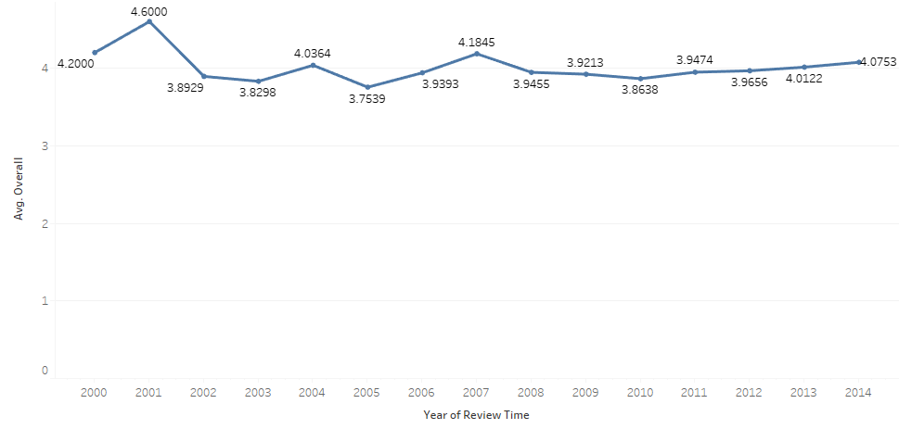
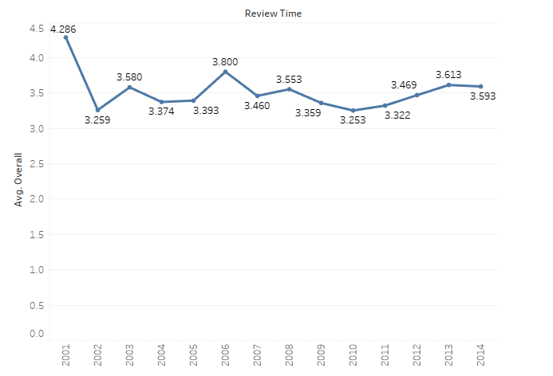
Average positive, negative and neutral ratings over the years for Toys & Games
Negative Sentiment
Neutral Sentiment
Positive Sentiment

Slide 16
Positive, Neutral and Negative words
Video Games
Toys and Games
Positive | Neutral | Negative | Positive | Neutral | Negative
Great Wow Awesome Good Loved | Easy Love Fun Pretty Easy | Can’t Bugs Mistake Instead Struggle | Super Fun Excellent Great Loved | Stale Great Disturbing Effortless Entertained | Crappy Annoying Heavy Hated Hard

Slide 17
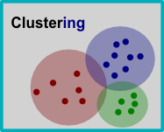
Clustering the Data

Slide 18
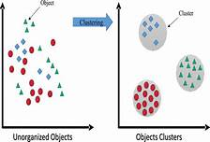
Clustering:
clustering is the task of grouping a set of objects in such a way that objects in the same group are more similar to each other than to those in other groups.
We are performing clustering on categories.
By doing clustering we are grouping similar categories together on the basis of polarity.

Slide 19
Steps done:
Doing DBSCAN.
From the outputs, The categories can be split into 3 cluster ids.
Taking the top 5 categories and last 5 categories based on their ratings.
Giving suggestions on how to improve the sales of products
with a relatively lower rating.

Slide 20
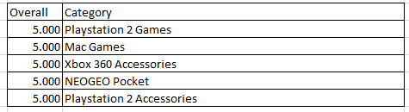
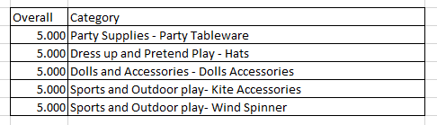
Top 5 Categories in the first cluster id:
Video_Games
Toys_and_Games

Slide 21
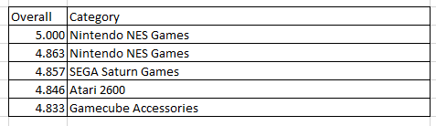
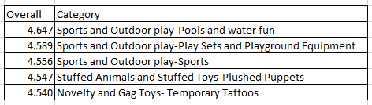
Top 5 Categories in the second cluster id:
Video_Games
Toys_and_Games

Slide 22
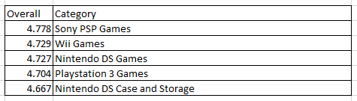
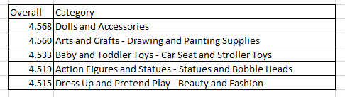
Top 5 Categories in the third cluster id:
Video_Games
Toys_and_Games

Slide 23
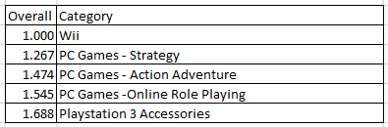
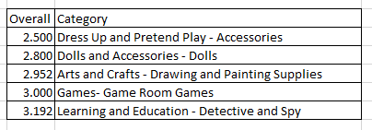
Last 5 Categories in the first cluster id:
Video_Games
Toys_and_Games

Slide 24
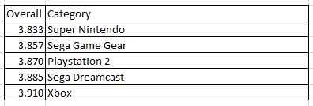
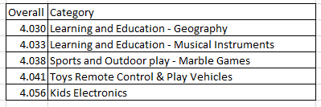
Last 5 Categories in the second cluster id:
Video_Games
Toys_and_Games

Slide 25
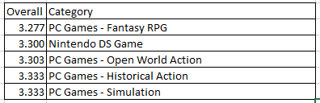
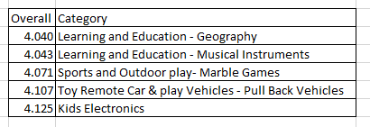
Last 5 Categories in the third cluster id:
Video_Games
Toys_and_Games

Slide 26
Suggestions:
The categories which has an overall mean rating of above 4, has a positive sentiment and need not be tampered with.
The categories which has an overall mean rating of 3 to 4 is having reasonably positive sentiment. Features for some of the categories can be improved based on customer feedback.
The categories which has an overall mean rating below 3 are having a negative sentiment and complete overhauling is required to improve their ratings.

Slide 27

Time series analysis

Slide 28
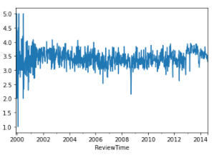
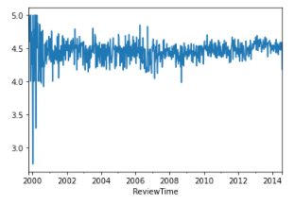
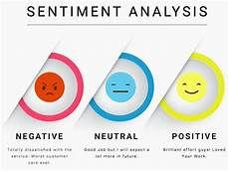
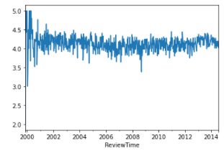
Overall ratings over the years for all the sentiments for Video Games
Negative Sentiment
Neutral Sentiment
Positive Sentiment

Slide 29
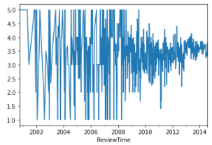
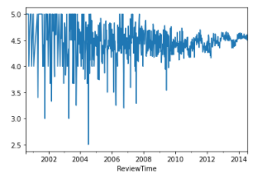
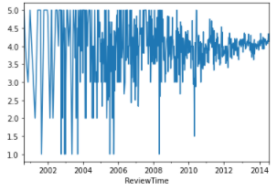
Overall ratings over the years for all the sentiments for Toys & Games
Negative Sentiment
Positive Sentiment
Neutral Sentiment

Slide 30
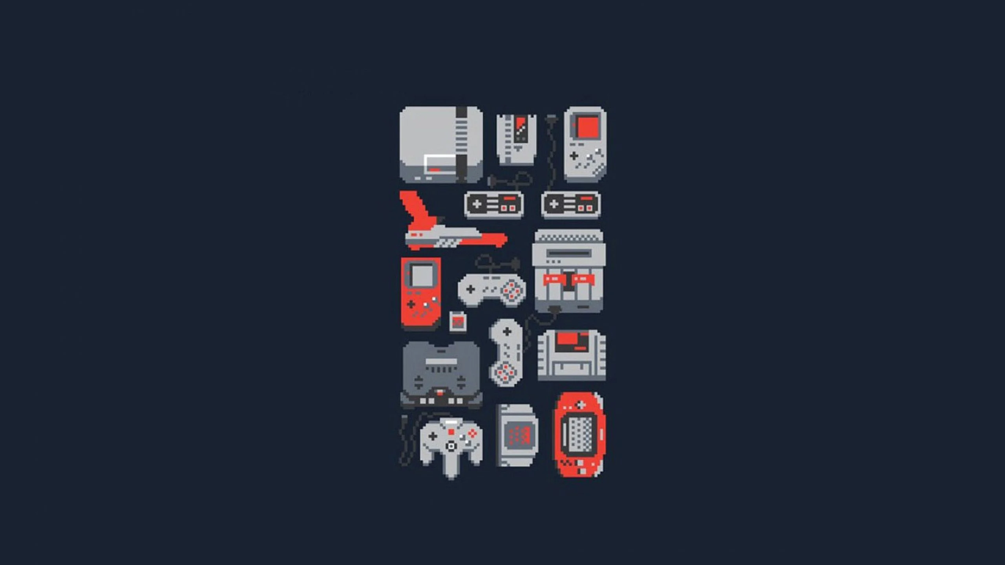
Video Games

Slide 31
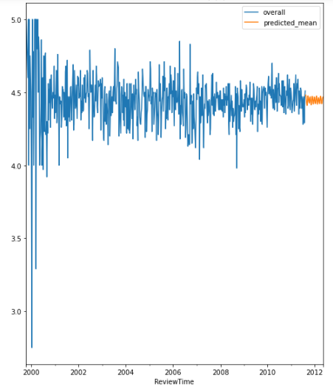
Forecast for categories with positive sentiment for video games
forecast

Slide 32
Analysis of ratings for categories with positive sentiment
Slightly upward trend is observed.
Chance of steady upward movement in the short run.

Slide 33
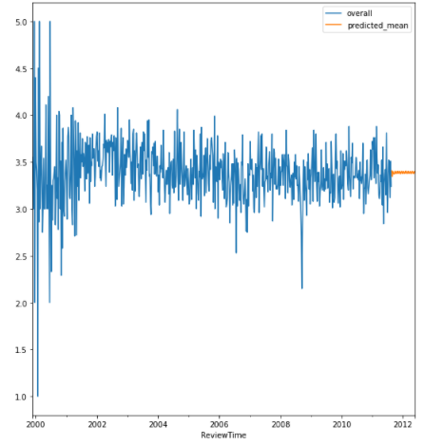
Forecast for categories with negative sentiment for video games
forecast

Slide 34
Analysis of ratings for categories with negative sentiment
There is neither growth or decrease of ratings for negative sentiment categories.
Better customer sentiment required for growth in this segment.

Slide 35
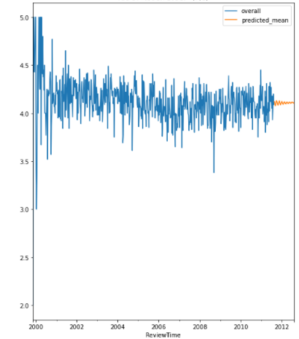
Forecast for categories with neutral sentiment for video games
forecast

Slide 36
Analysis of ratings for categories with neutral sentiment for video games
Neutral growth in the ratings.
There is hardly any movement in the ratings of the categories in the short run.

Slide 37
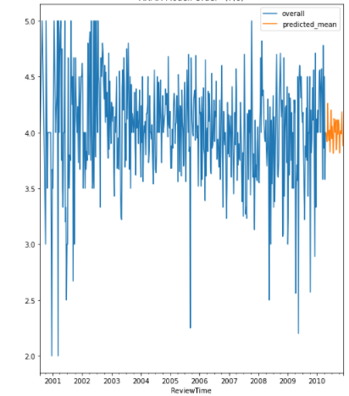
Forecast for a particular category with neutral sentiment for video games
Forecast for PlayStation 2 Games Category

Slide 38
Analysis of ratings for a particular category with neutral sentiment for video games
‘PlayStation 2 Games ’ will push up the ratings for the next few foreseeable weeks.
To sustain the upward trend this category has to be monitored closely.

Slide 39
Suggestions for ratings with Positive sentiments :
Categories with positive sentiments:
The ratings are high.
Positivities of the categories are to be projected to keep it at the top of the customer mind.
Some of the positive qualities of the categories has to be enhanced, so that their ratings can be increased.

Slide 40
Suggestions for ratings with Negative sentiments :
Categories with negative sentiments:
Flat graph is being observed.
To improve the ratings some the products need to be replaced with newer products based on customer feedback.
They can be tagged with products with better customer ratings to create customer interest thus enhancing their ratings

Slide 41
Suggestions for ratings with Neutral sentiments :
Categories with neutral sentiments:
No Growth is being observed.
For increasing the ratings further ask questions to customers.
Ask what they find positive about the category.
Ask what they find negative about the category.
Take steps to improve the quality depending upon the customer response.

Slide 42

Toys and Games

Slide 43
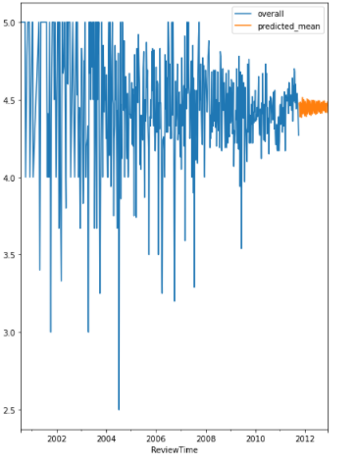
Forecast for categories with positive sentiment for toys and games
forecast

Slide 44
Analysis of ratings for categories with positive sentiment
For positive sentiment we can see the ratings are more or less remaining the same over the next few weeks.
To maintain a steady growth in the ratings steps has to be taken depending upon market feedback.

Slide 45
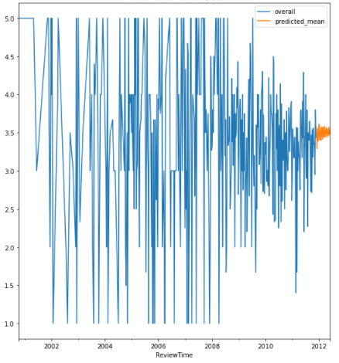
Forecast for categories with negative sentiment for toys and games
forecast

Slide 46
Analysis of ratings for categories with negative sentiment
Ratings are steadily increasing.
Positive response from customers.
Increase in ratings suggest that there is a positive vibe being seen in this category.

Slide 47
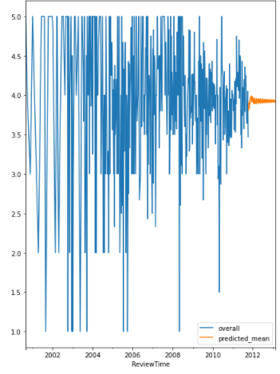
Forecast for categories with neutral sentiment for toys and games
forecast

Slide 48
Analysis of ratings for categories with neutral sentiment for video games
For neutral sentiments there is a flat graph.
No significant interest either positive or negative is observed.

Slide 49
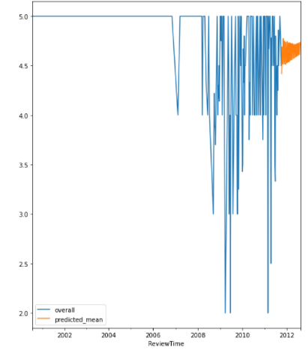
Forecast for a particular category with negative sentiment for toys and games
Forecast for Building Games Category

Slide 50
Analysis of ratings for a particular category with negative sentiment for toys and games
Sentiment for ‘Building Games Category’ is showing positive growth.
To sustain the upward trend this category has to be monitored closely.

Slide 51
Suggestions for reviews with Positive sentiments :
Categories with positive sentiments:
The ratings are high.
We need to project the positives of the categories from time to time to keep it at the top of the customer mind.

Slide 52
Suggestions for reviews with Negative sentiments :
Categories with negative sentiments:
Robust marketing strategies are needed to sustain the upward trend of ratings.
Products whose ratings are showing a downward trend need to be dropped out of the categories.

Slide 53
Suggestions for reviews with Neutral sentiments :
Categories with neutral sentiments:
More promotions needed based on customer feedback to achieve a higher rating.
New inputs and marketing strategies needed for some products in this category for achieving higher ratings.

Slide 54
Linking with problem statement
We found out by the means of clustering all the top 5 categories and last 5 categories for different cluster ids.
Time series forecasting method used for identifying categories with high demand:
Categories with positive sentiments will be in demand as it’s rating will increase for video games.
Categories with negative sentiments will be in demand as it’s rating will increase for toys and games.

Slide 55
Conclusion
Overall, the outlook is positive or steady for all the categories of products.
Products in positive category is showing an upward trend due to increased favourable sentiment for Video Games.
The trend is showing that products in neutral category is hardly creating any positive sentiments among the customers.
The graph in the negative category has shown an improvement and in the short term the trend is going to get positive on the back of high ratings of Toys and Games.

Slide 56
Thank You!

